Slide 1
Topic Modeling Yelp Reviews
By Sentiment
Capstone Project 2 • Miguel Montano

Slide 2
Problem Statement
The Problem
Potential Clients
A Solution
Thanks to resources like Yelp, consumer perspectives of individual businesses are currently plentiful, but finding actionable insight remains the proverbial needle in the haystack
Individual Businesses being reviewed on Yelp
Analysts seeking sentiment specific topics in a sector
Special interest groups dedicated to local industries
I propose an approach that utilizes the existing rating system in Yelp reviews to infer sentiment, attributing low and high ratings to negative and positive sentiment respectively, and creating a Scikit-Learn pipeline that trains a Latent Dirichlet Allocation Topic Model for each set, extracting topics that are being discussed when users write reviews with strong opinions

Slide 3
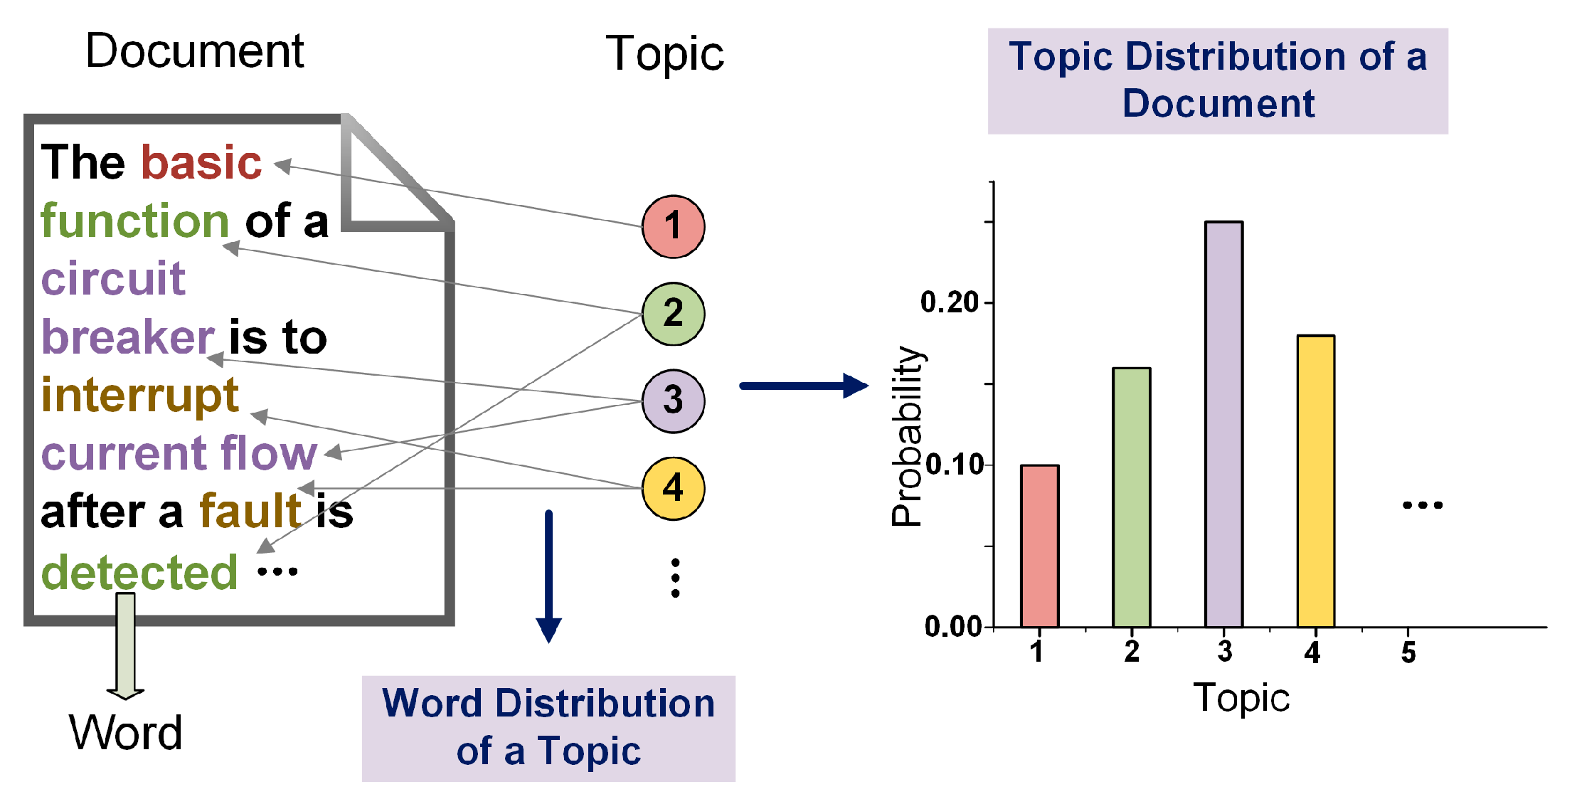
Background - Latent Dirichlet Allocation (LDA)
‘generative probabilistic model’
Sets of observations can be described by unobserved groups, ‘Topics’, that explain similarities between parts of the data
If observations are words collected into documents, each document is a mix of some topics and each word’s presence is attributable to a topic
Works as a way of ‘soft clustering’ the documents, as each can belong to a combination of topics, which is key in this case as reviewers may write about more than one subject

Slide 4
Delineate Procedure To Prepare for Modeling
Text preprocessing
Sentiment partitioning
Feature extraction
Create Scikit-Learn Pipeline to Streamline Process
Construct custom objects
Provide usage examples:
Individual Business
Food Industry
Methodology
Exploratory Data Analysis
Data Wrangling
Baseline Model
LDA Pipeline
Visually & Statistically Summarize Main Characteristics
Business profiles
Star ratings
Reviews
Test LDA Model
Prepare data succinctly
Train on subset
(Food Industry Reviews)
Visualize using pyLDAvis

Slide 5
Exploratory Data Analysis
Business Profiles
Overview
Deep Dive into Top States
Location of Businesses
Business Count
Average Star Rating
Distribution of Ratings
Average Number of Reviews Per Star Rating
Categories
Food Industry Subset
Business Profiles
Average Star Rating Per Year
Reviews
Average Length of Reviews Per Star Rating
Distribution of Review Lengths By Year
Datasets were originally in a JSON format,
and each was imported into Pandas DataFrames
Links to Data:
Yelp Academic Dataset
Taxonomy Of Yelp Categories
U.S. & Canada State/Province Codes

Slide 6
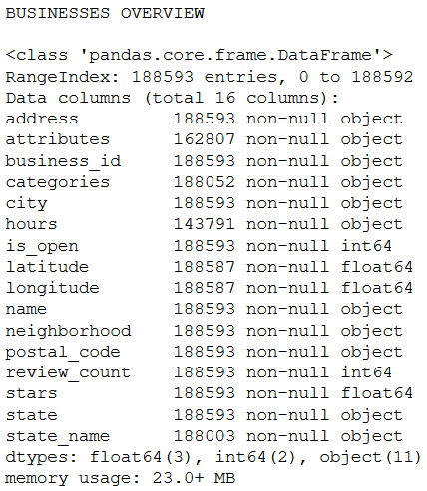
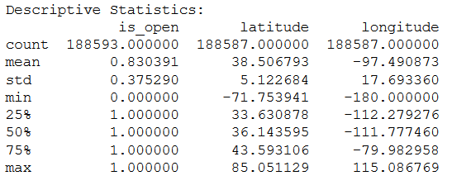
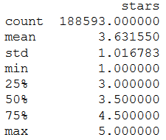
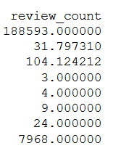
Business Profiles Overview
Highlights:
5,996,750 reviews are accounted for in Business DataFrame (99.996% of All Reviews)
99.14% of All Businesses are in the Top 10 States

Slide 7
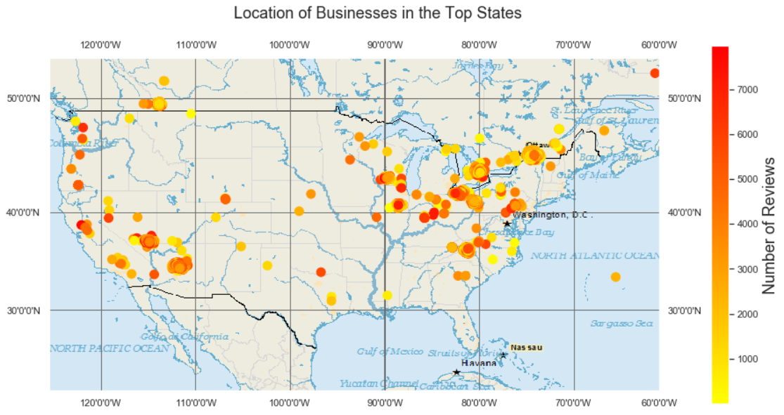
Location of Businesses in the Top States

Slide 8
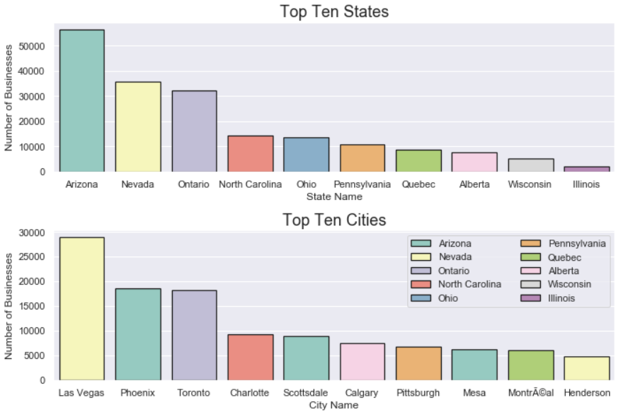
Top Locations by Business Count

Slide 9
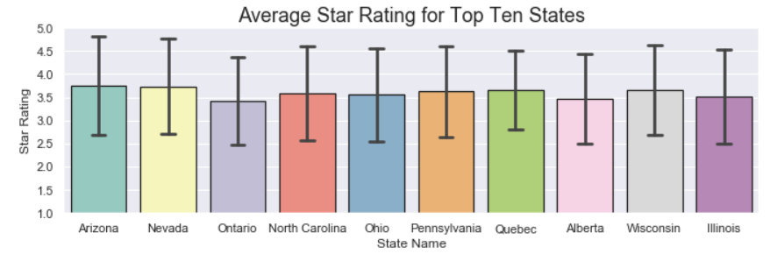
Average Star Rating By State

Slide 10
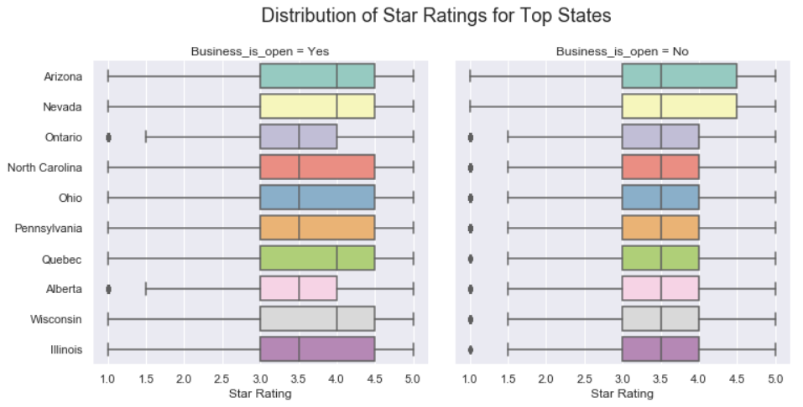
Distribution of Star Ratings for Top Ten States

Slide 11
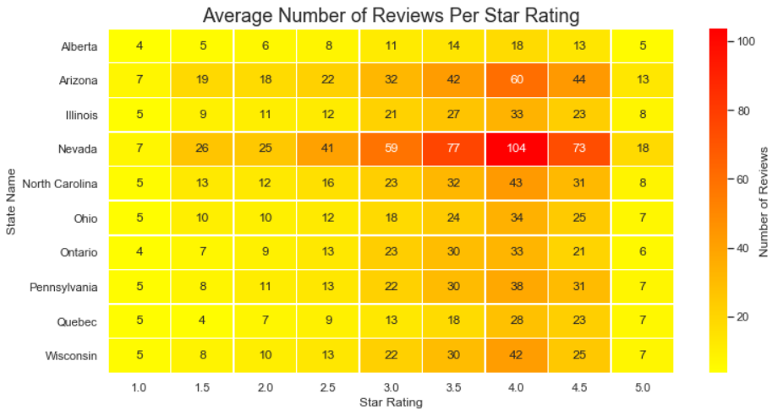
Average Number of Reviews Per Star Rating For Top States

Slide 12
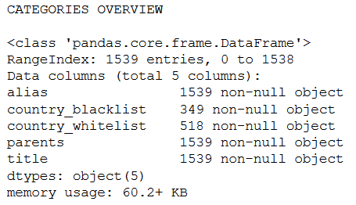
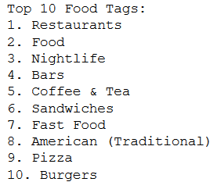
Categories Overview & Top Ten Food Tags
Highlights:
There are 118 unique parent tags, and categories can possess multiple parents
Of the Top 10 Food tags, numbers one and two have a higher frequency in the overall Yelp dataset than the next eight combined, which might be because they are typically used in combination with other more specific tags

Slide 13
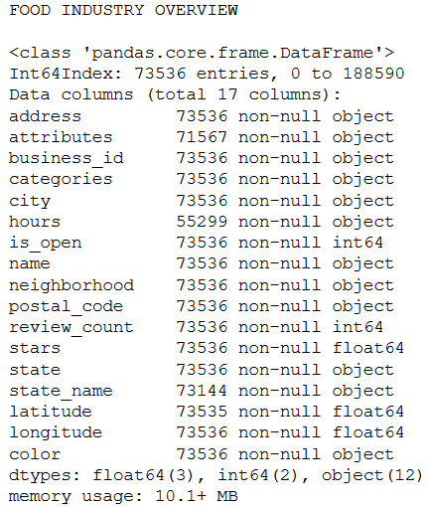
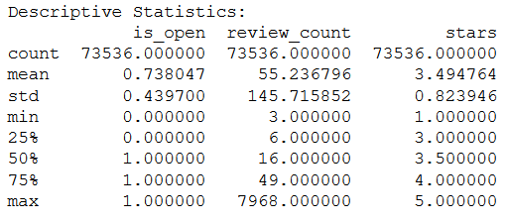

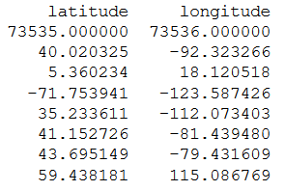
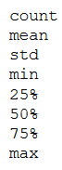
Food Industry Business Profiles Overview
Highlights:
38.9% of all businesses profiles belong to the Food industry
Food establishments have 20 more reviews per business than the population average (55.2 vs. 31.8)
Closing rate is 9.2% higher for food businesses

Slide 14
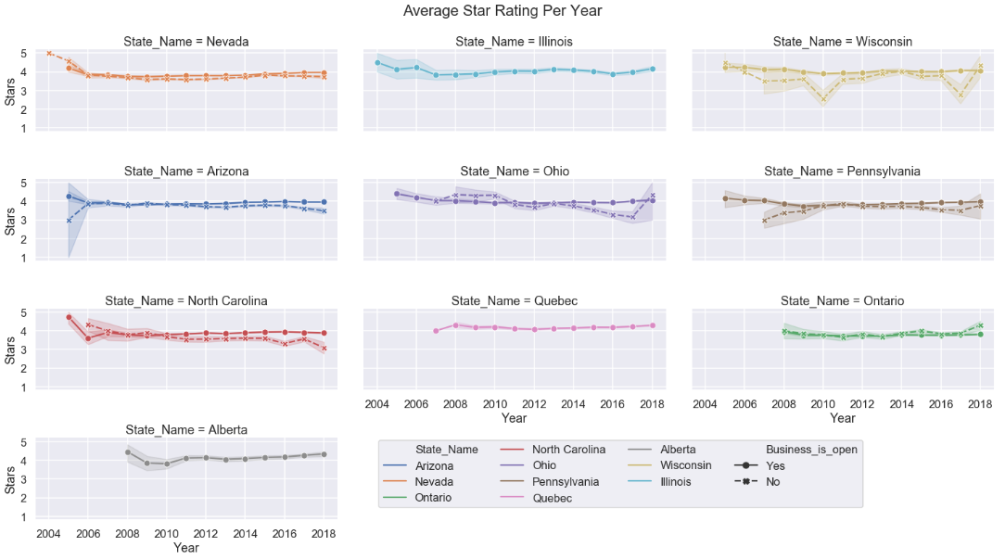
Average Food Industry Star Rating Per Year for Top States

Slide 15
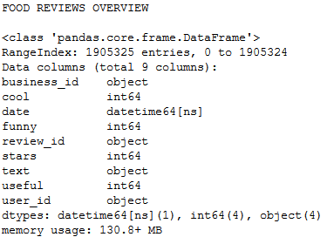

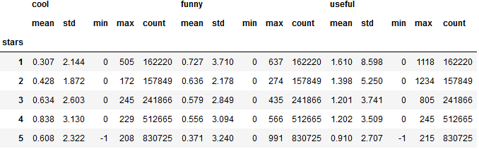
Food Industry Reviews
Highlights:
31.7% of all reviews in Yelp academic dataset are for businesses in the food industry
A majority of reviews do not garner any additional ‘cool’, ‘funny’, or ‘useful’ tags
If they do have such a tag, it is likely that they are reviews giving favorable ratings of 4-5 stars (70% of all reviews and 68% of reviews with additional tags)

Slide 16
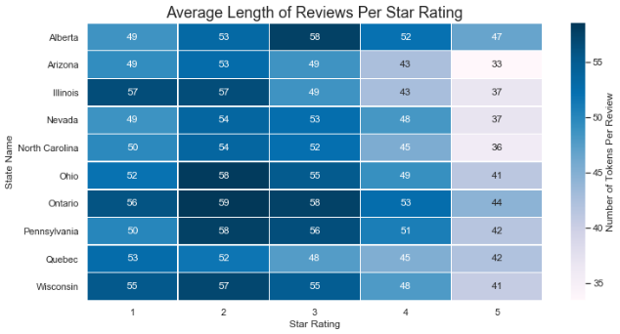
Average Length of Food Industry Reviews Per Star Rating

Slide 17
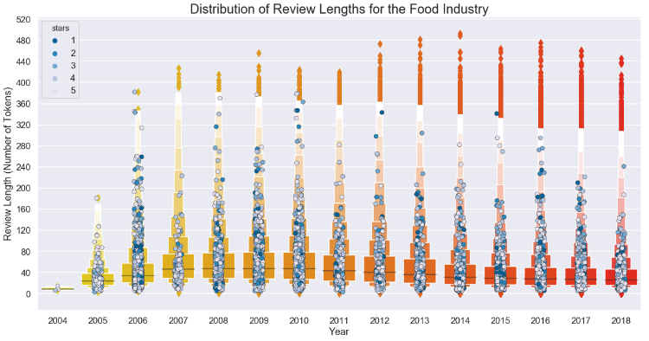
Distribution of Review Lengths By Year for the Food Industry

Slide 18
Data Wrangling
Text Preprocessing
Tokenization
Normalization
Stopword Removal
Lemmatization
Sentiment Partitioning
‘negative’ or ‘positive’
Based on star rating
Feature Extraction
Map words to unique integer ids
Collect word frequency
Create vector space corpora
Each review becomes a ‘bag-of-words’
Two sets of document-term matrices, one for ‘negative’, and one for ‘positive’ reviews
With Gensim, NLTK, and Pandas libraries
Using Food Industry reviews subset
Define steps to be implemented in future pipeline

Slide 19
Text Preprocessing
Tokenization
Remove punctuation/special characters and transform passages from one long string into lists of word strings
04
Lemmatization
Eliminate affixes from a word by capturing the canonical forms based on a word's lemma, or chosen representative, in this case assigning a Verb category tag to the tokenized parts of a sentence
01
03
Normalization
Convert all text to lower-case, expand contractions, remove numerals and accent marks
Stopwords Removal
Remove words below three characters, and those which contribute little to overall meaning
02

Slide 20
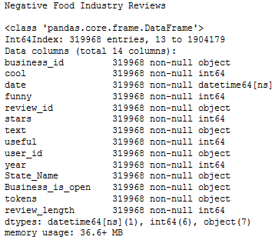
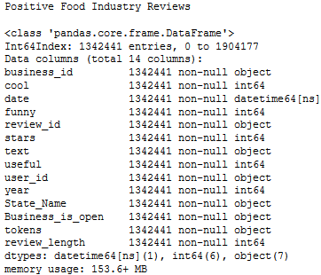
Sentiment Partitioning
Negative Reviews
Positive Reviews

Slide 21
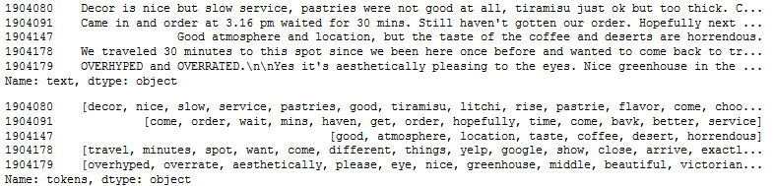
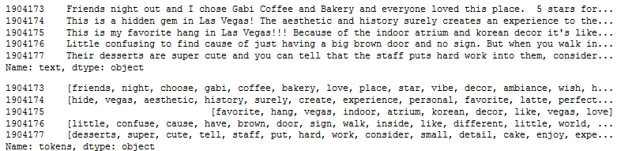
Post Text Processing
Negative Food Industry Reviews
Positive Food Industry Reviews

Slide 22
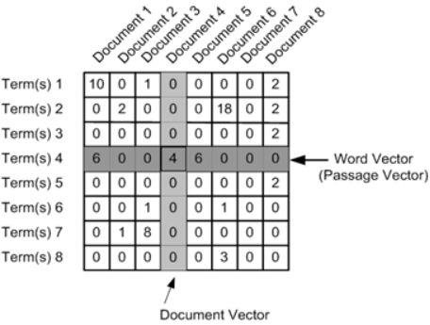
Feature Extraction
Document-Term Matrix
Vector Space Corpus
Using a trained Dictionary, tokenized terms in reviews are converted to their integer ids, and paired with their Frequency or TF-IDF weighting, resulting in a sparse vector. This representation is known as a ‘Bag-of-Words’, as it disregards grammar and even word order but maintains multiplicity
Gensim Dictionary
A mapping between words and their integer ids, created from the normalized tokens in each corpus (set of documents) by sweeping across them, assigning a unique integer id to each word, and then collecting word counts and other relevant statistics
LDA Model

Slide 23
Baseline Model
Using Gensim LDA model
Trained on Food Industry reviews
One instance for each sentiment
Ten topics per model
Unigrams or (bag-of-words) vectors
Ignores context or phrasing

Slide 24
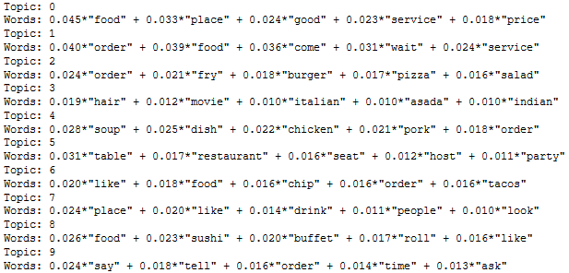
Baseline - Negative Review Topics

Slide 25
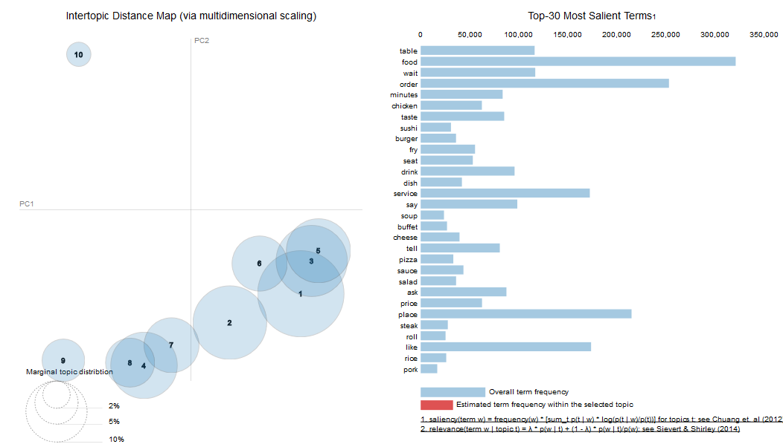
Baseline - Negative Review Topics

Slide 26
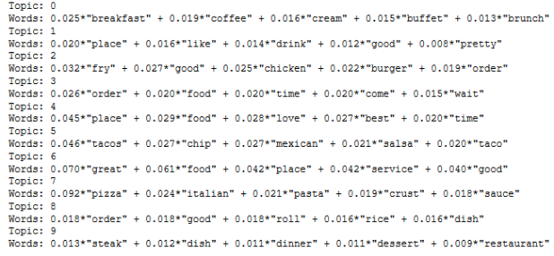
Baseline - Positive Review Topics

Slide 27
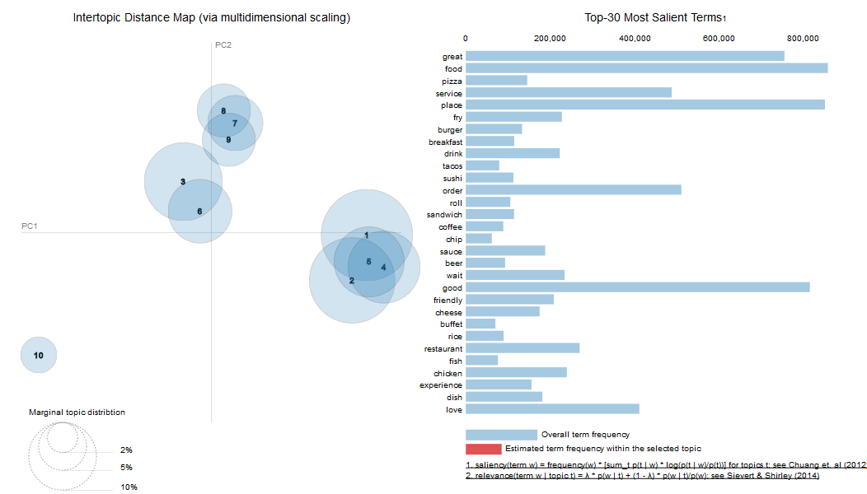
Baseline - Positive Review Topics

Slide 28
LDA Pipeline
Components
Transformers
Yelp Review Selector
Preprocess
Vectorize
Estimator
LDA Estimator
Implementation
LDA Metrics
Combination of graphical and statistical evaluations
Individual Business Example
Food Industry Example
Sequentially applies the transformations necessary for generating a topic model
Custom objects were built by wrapping Gensim modules and Pandas functions, while inheriting Scikit-Learn BaseEstimator and TransformerMixin classes

Slide 29
Pipeline Components
LDA Estimator
Trains an instance of Gensim’s Latent Dirichlet Allocation Model, with the option to create a pyLDAvis figure from the result
Vectorize
Create a vector space of features, where each feature is a sparse vector extracted from each document, in this case preprocessed Yelp reviews, consisting of terms and term weights.
4
3
Preprocess
Preprocess text data, in this case the Yelp reviews themselves, per specifications; with the option to expand final vector space with n-grams..
2
Yelp Review Selector
Selects Yelp reviews based on specified criteria, with the option of returning all review data in a pandas DataFrame, or simply the review text filtered by sentiment as a pandas Series.
1

Slide 30
LDA Metrics
Statistical Measures
Graphical Representations
Approximate how well the probability model predicts topic based on given samples:
Variational Bound
Log Perplexity
Attempts to represent numerically how interpretable topics are to humans:
Coherence Model
Topic Terms and Weights
Most Representative Review Per Dominant Topic
Distribution of Topic Contributions
Dominant Topic Frequency
Dominant Topic Distribution Among Documents
pyLDAvis Visualization

Slide 31
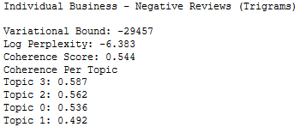
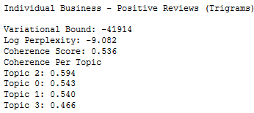
LDA Pipeline - Individual Business Example
Construction
Scores
A random business with at least 500 reviews was selected, ‘Postino Arcadia’ from Phoenix, Arizona
Two separate pipelines were constructed, one for negative (3 or less star) reviews, and one for positive (4-5 star) reviews
Using term frequency weighting, possessing trigrams, and removing the two most frequent tokens, as well as any tokens occurring in less than two reviews
Ten passes were run over the training corpora, and four topics were drawn

Slide 32
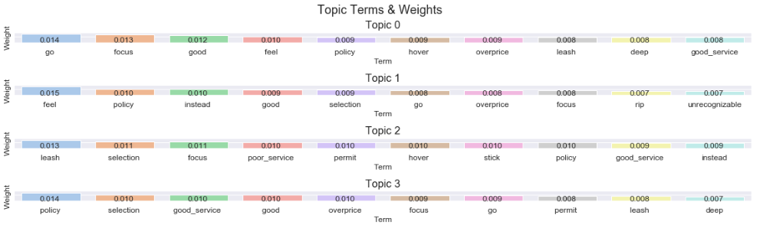
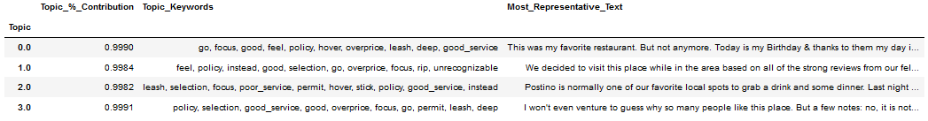
Individual Business Example - Negative Review Topics

Slide 33
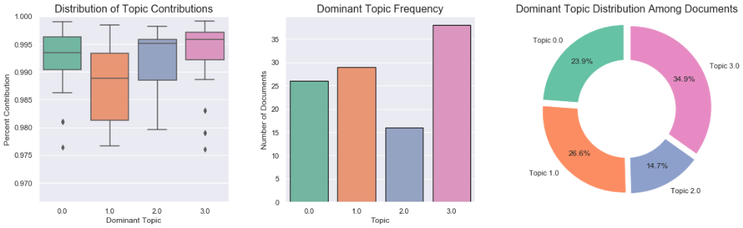
Individual Business Example - Negative Review Topics

Slide 34
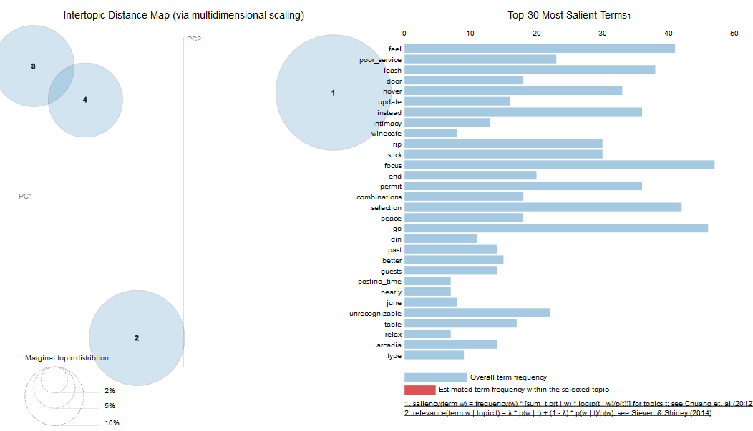
Individual Business Example - Negative Review Topics

Slide 35
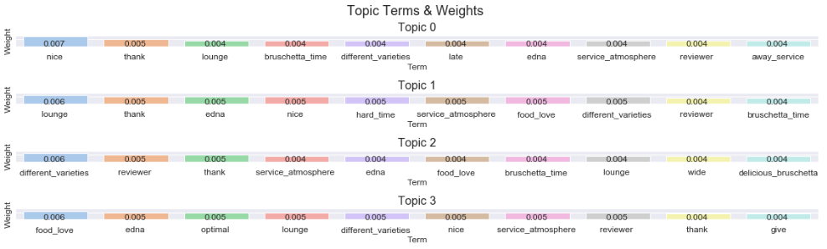
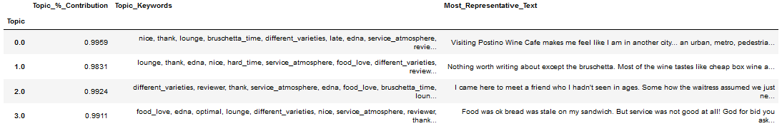
Individual Business Example - Positive Review Topics

Slide 36
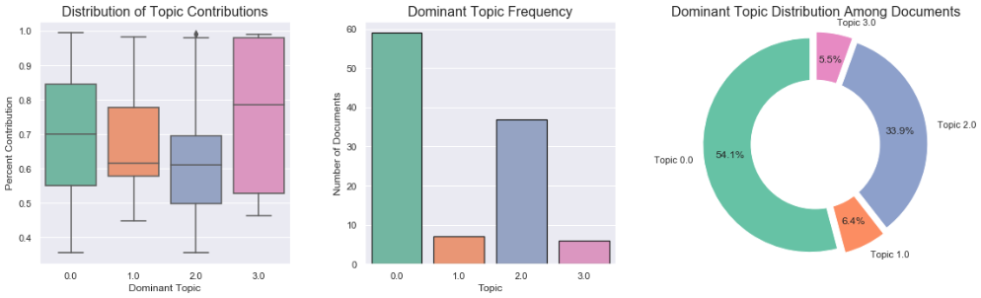
Individual Business Example - Positive Review Topics

Slide 37
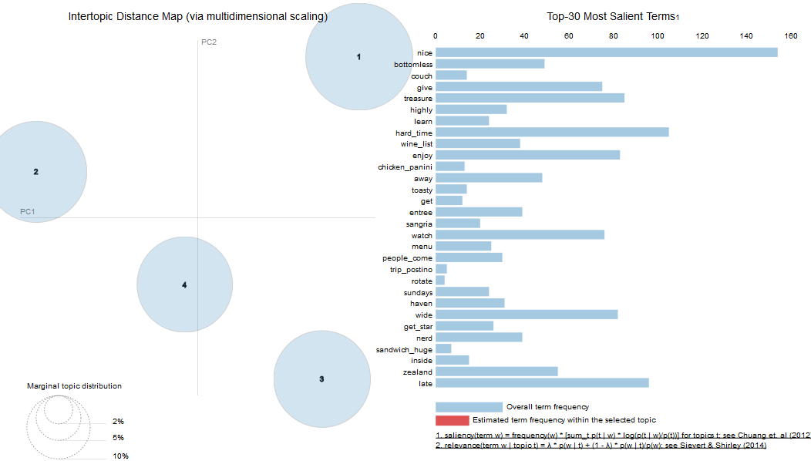
Individual Business Example - Positive Review Topics

Slide 38
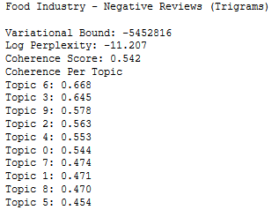
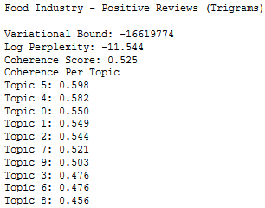
LDA Pipeline - Food Industry Example
Construction
Scores
For a more global analysis using dataset with a wide variety of constituents, in this case taking another look at the Food Industry reviews used in the baseline model
Two separate pipelines were constructed, one for negative (1-2 star) reviews, and one for positive (4-5 star) reviews
Using term frequency weighting, possessing trigrams, and removing the three most frequent tokens, as well as any tokens occurring in less than ten reviews
Larger sample size allows for splitting into train/test sets, as may be necessary in real-world scenarios, where trained models may need to be tested against new emerging data

Slide 39
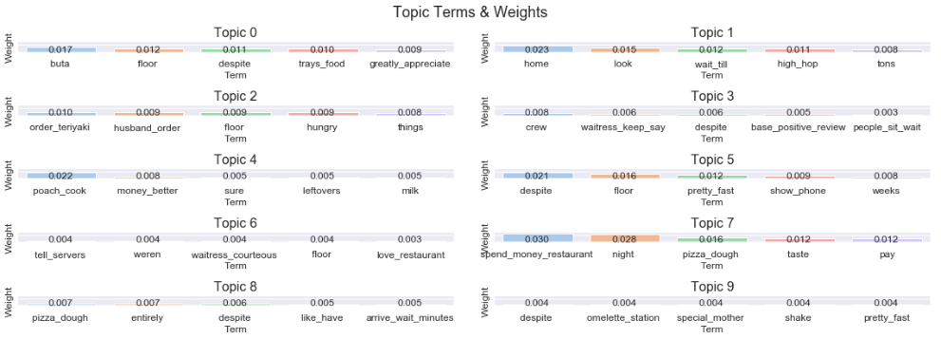
Food Industry Example - Negative Review Topics

Slide 40
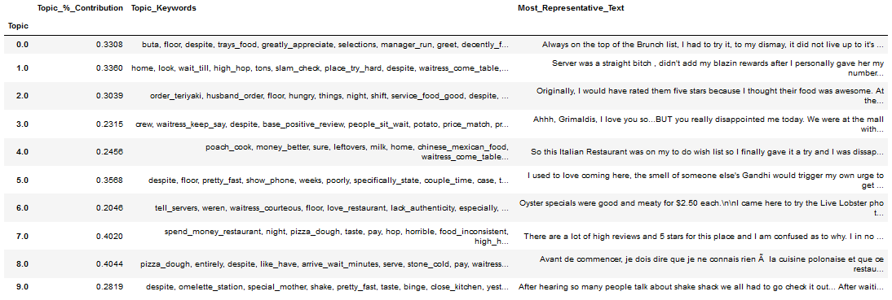
Food Industry Example - Negative Review Topics

Slide 41
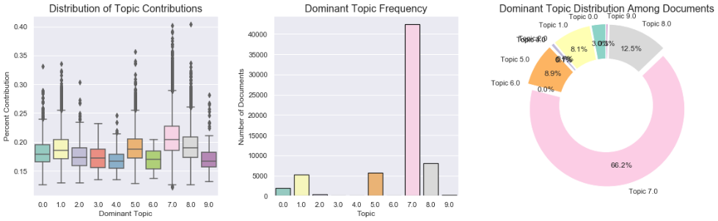
Food Industry Example - Negative Review Topics

Slide 42
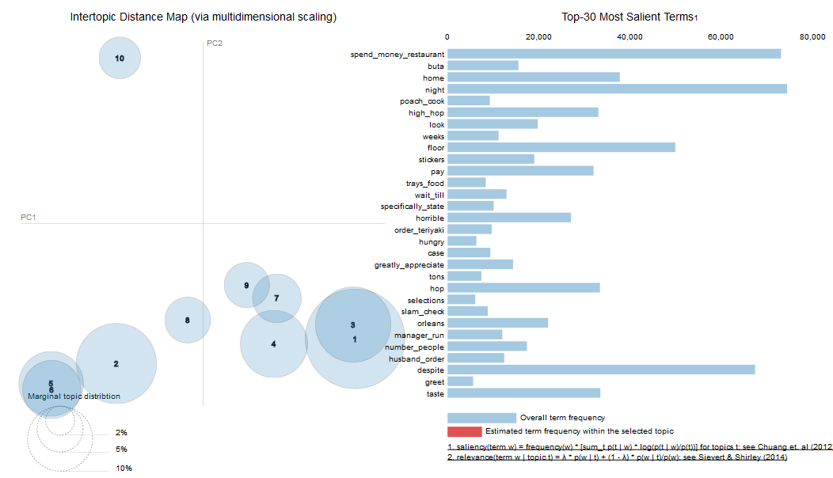
Food Industry Example - Negative Review Topics

Slide 43
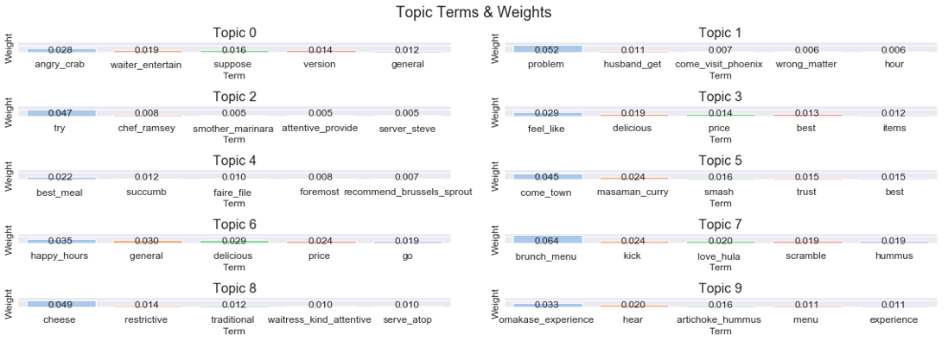
Food Industry Example - Positive Review Topics

Slide 44
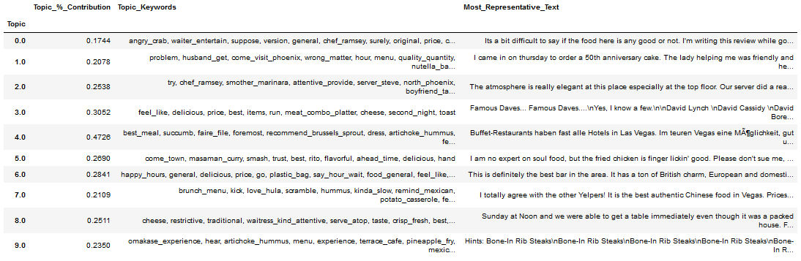
Food Industry Example - Positive Review Topics

Slide 45
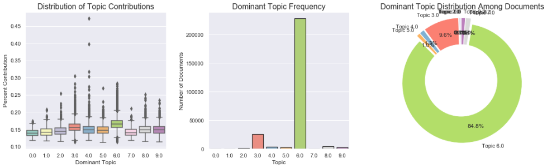
Food Industry Example - Positive Review Topics

Slide 46
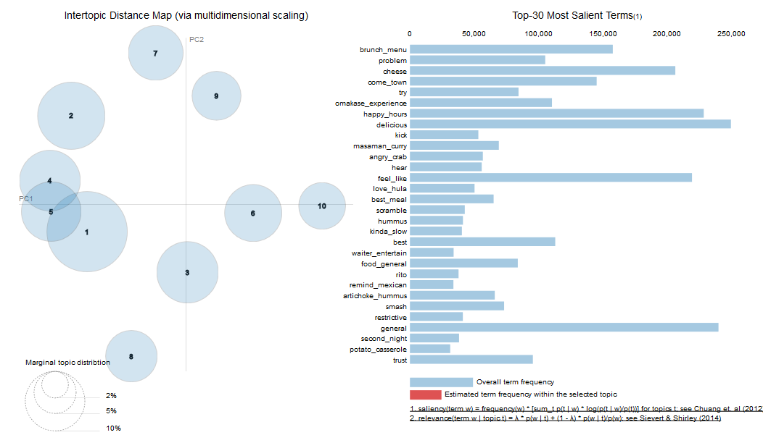
Food Industry Example - Positive Review Topics

Slide 47
Client Recommendations
Based on the possible implementations of the product constructed and the results that may obtained from it, the following are some insightful uses that I would promote to any future clients:
To determine the direction of favorability for a particular product or initiative
Success of a loss-leader in creating profitable upsell scenarios
Response to rebranding or new
marketing strategy
Reception of an aesthetic change such as a remodel or relocation
To assess global versus local analysis
Alongside a market penetration analysis to boost insight
Verifying Consistency in customer service across localities for a chain of businesses
Distinguishing between circumstantial and pervasive issues for a particular industry

Slide 48
Conclusion
In constructing this text analysis pipeline I encountered several problems consistent with common parables in reference materials, a notable one being that the quality of the topic model output rests tremendously on the quality of the preprocessing steps taken prior to training. The initial extraction of the text data from the overall Yelp academic dataset, and the subsequent transformation into a serviceable vector that can be used to train an LDA model, were both some of the most computationally expensive and consequential aspects of the overall procedure. Minor changes in these steps, such as filtering the vocabulary or adding n-grams to the corpus, often led to drastically differing results, which themselves proved uniquely challenging to interpret. Moving forward I would add more visualizations such as word clouds to assist in readability, as the success of each topic model created hinges on a combination of the user’s domain knowledge and the ease in which it can be interpreted

